Slide 1

DriverPass System Analysis
Guilherme Pereira
Notes:
DriverPass Final Project Presentation
Author: Guilherme Pereira
Date: October 17th, 2021

Slide 2

System Requirements
Nonfunctional Requirements:
The system’s security requires a verified email and password.
The system’s platform is any operating system that can support a web-browser.
Functional Requirements:
The system shall allow students to create accounts to take online courses.
The system shall allow administrators to modify accounts.
Notes:
There are multiple functional requirements for this system that are required to make it work. These include operations the system will perform, such as allowing students to create and login to their accounts, modify accounts from within or outside (such as an IT officer), and allow students to take online courses. Additionally, there are other functional requirements that covered different roles such as the administrator in allowing them to print a user’s activity report and allowing the secretary to approve a student’s reservation. Functional requirements express more of the user needs.
The nonfunctional requirements selected are things that do not need to be part of the system, but can be measured in terms of strength, speed, quality, and quantity. For instance, a system’s password security needs to be up to standard by including more than 8 characters, having at least 1 letter and 1 special character. However, despite it being a strong standard, it does not guarantee this will work for every case (some people may have a weaker password despite the standard). A system’s platform should be able to run a web-browser, but if any modifications were made to that OS that are not within the capabilities of the browser, then it is not guaranteed that the system will perform as needed. Nonfunctional requirements express more of the quality of the user experience, but not their needs.

Slide 3
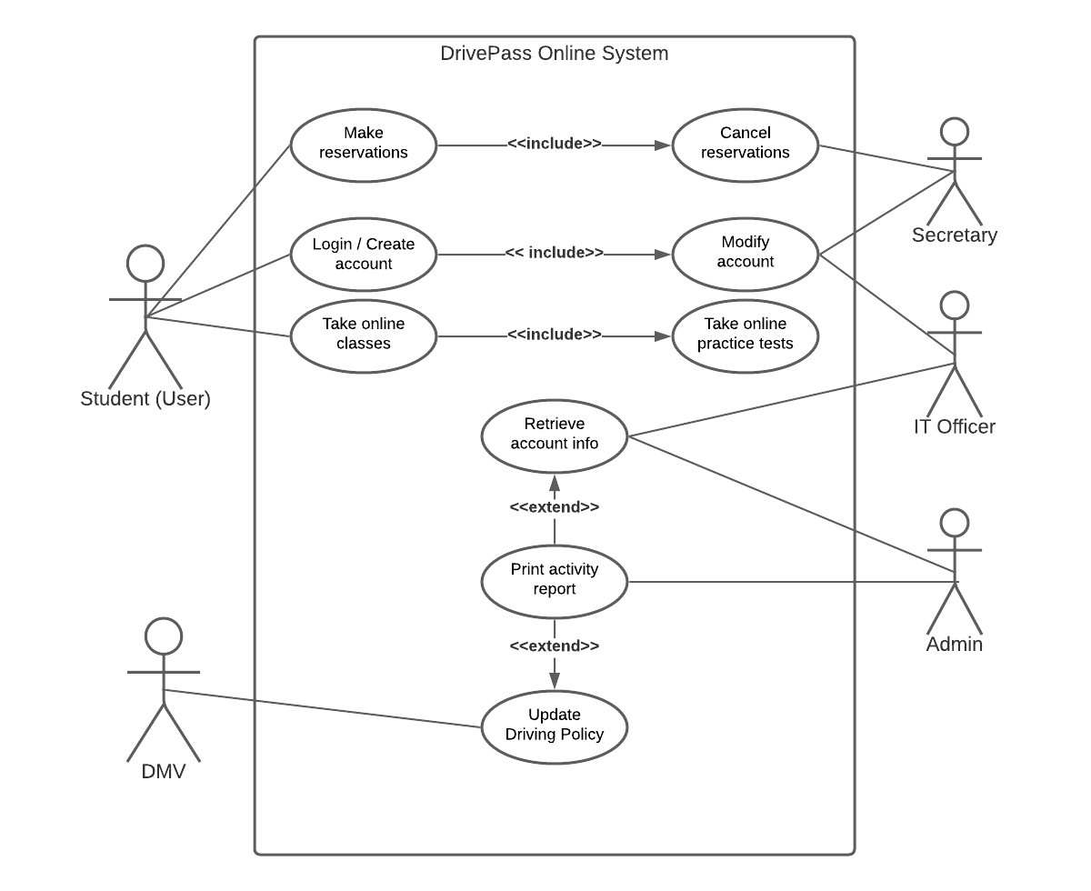
Use Case Diagram
Notes:
This diagram fulfills the needs of DriverPass by taking every person who will be interacting with this system. It also describes the different actions each person can do with the system. The diagram shows the different people and roles they can fulfill by using DrivePass.
Students can:
Make reservations and cancel them if approved
Login and create an account as well as modify it to an extent
Take online classes and courses
Secretary can:
Cancel reservations or confirm them for users
Modify an account
IT Officer can:
Modify an account further by removing them from the system
Retrieve account information if needed
The Admin can:
Retrieve the account information
Print the activity report that comes from the account
Print the updated driving policy sent by the DMV
The DMV can:
Update their driving policy

Slide 4
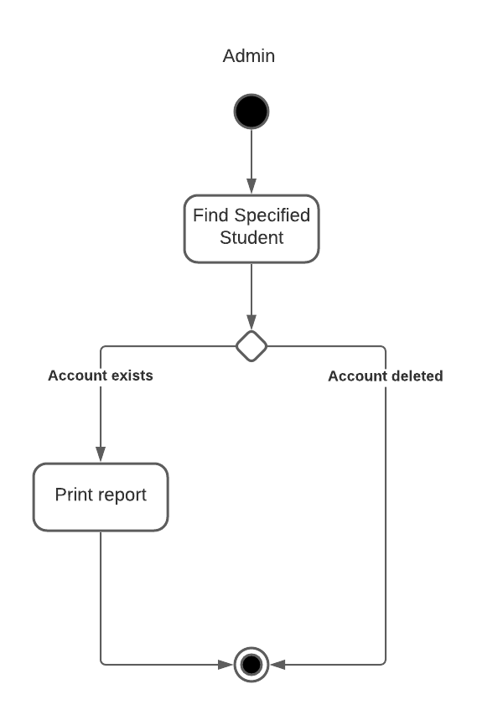
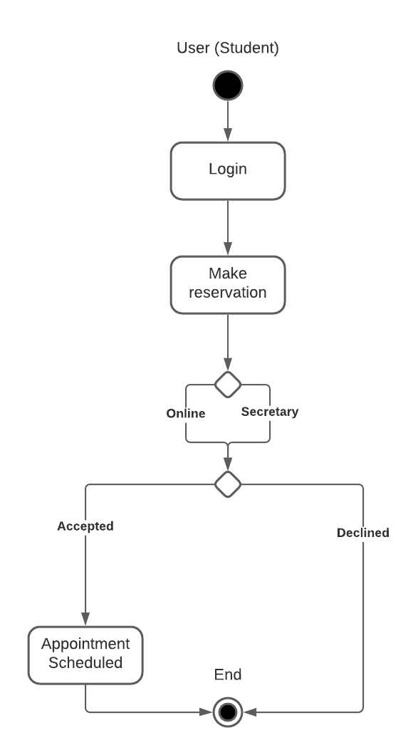
Activity Diagram
Notes:
There are two different use cases being broken down in this diagram: The activity report and make reservation use cases. Each activity diagram shows the different steps that can be taken and what those choices result in. While not detailed, each diagram explains how a use case should run under normal circumstances.
Print Report:
Administrators can print the report of a student.
If the student’s account exists, print a report on their account
If the student’s account does not exist, do not print report.
Make Reservation:
Student must login first
Student can make a reservation by contacting the secretary or setting up online.
If accepted, reservation will be set.
If declined, reservation will be cancelled.

Slide 5
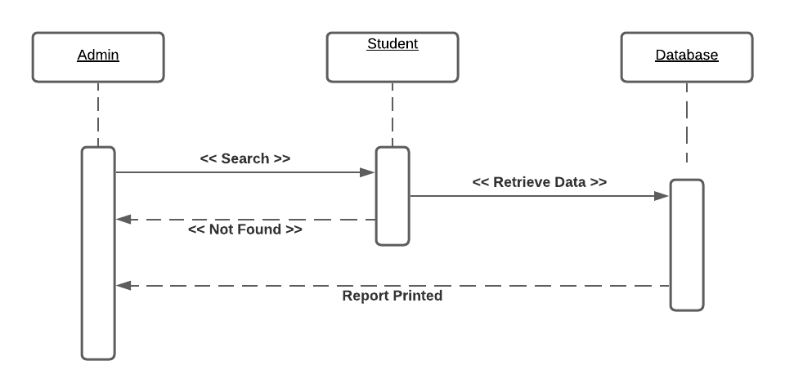
Sequence Diagram (Activity Report)
Notes:
The sequence diagram shows how a use case is performed over time. Starting from the top left, we have the admin who wants to first search a student in the system. If the student does exist, the database, or data storage, will retrieve information regarding that student and send it back to the admin. If the student does not exist, a prompt will be given to the admin.
The sequence diagram is as follows:
The admin requests to search a specific student
If the student is found, the information is then retrieved from the database and returned to the admin
If the student is not found, a message stating that the student is not in the system will be delivered back to the admin.

Slide 6
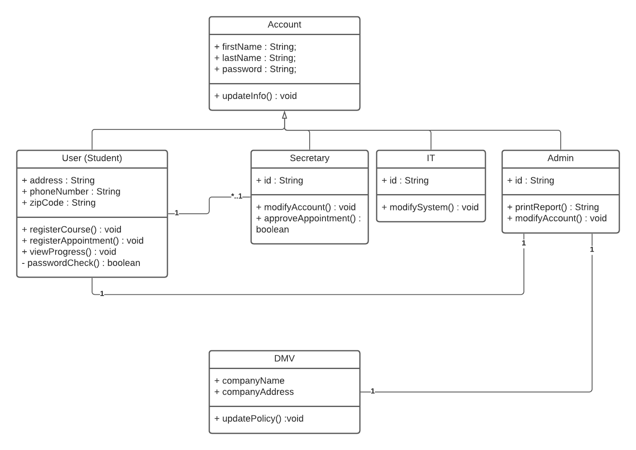
UML – Class Diagram
Notes:
The class diagram shows what attributes and values each part of the system has. While these attributes do not have any specific interactions with one another, it shows the different relationships they may have as well as the different values and operations they can do. Additionally, some associations such as that of the secretary and student show that there can be multiple students to 1 secretary, but there is only 1 secretary per student.
Each box represents an object that has different attributes.
Name
Password
Address
Each box also has different actions they can perform.
Register for a course
Modify an account
Print an activity report

Slide 7
Security
E-mail and password login
Driving instructors review only selected student information
Administrators print activity report of users.
Notes:
Security is important in keeping the users and those who handle information safe. For this system, we use an E-mail and password login to help users have a secure way of entering and using this system. Additionally, assigned drivers may only review information of the students they were assigned and not anyone else, as this may infringe of the privacy of others. Finally, the administrator may print an activity report of the user to show their progress or handle any payment issues a user may encounter when using the system. The activity report is also an additional layer of security as it helps to protect the student from fraudulent information; in the case that they lose their account, the activity report can verify the integrity of the original user and restore the rights to them.

Slide 8
System Limitations
Finite number of driving instructors
Unknown cloud service subscription.
Microsoft Azure
Amazon Web Service
No budget
Notes:
While not explained much by the representatives of DriverPass, there does seem to be a finite number of driving instructors. There are 10 cars available to be used as well, so if the programs were to become popular and attract many customers, those finite resources would limit how the system operates. Additionally, the owner of DriverPass expressed that they want to use a cloud-based operating system but made no mention of which service to use. There exist several services with varying price ranges and performance. Finally, no budget has been placed in creating this system or the people who are to handle them. We have the users, secretary, IT officer, and admin as well as the DMV, but there is no mention as to how the instructors are to use this system or what the quality of the system should be.

